Slide 1
Clustering Advanced Machine Learning with Python

Slide 2
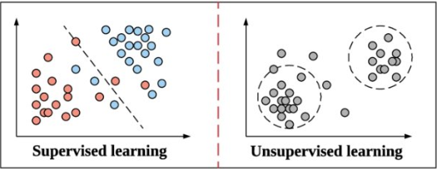
Unsupervised Learning
In supervised learning, we have a response variable of which we attempt to accurately predict.
In unsupervised learning, there is no response variable.

Slide 3
What are the components?
First, we divide the data into groups so the observations in each group are similar.
Each group is called a cluster.
Some examples: advertisers, medical records, Netflix, YouTube…
The key question is how we define distance/dissimilarity between the data points.

Slide 4
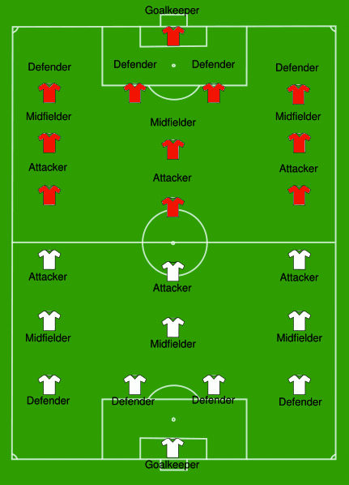
Clustering

Slide 5
Clustering

Slide 6
Clustering

Slide 7
Clustering

Slide 8
Clustering

Slide 9
Clustering

Slide 10
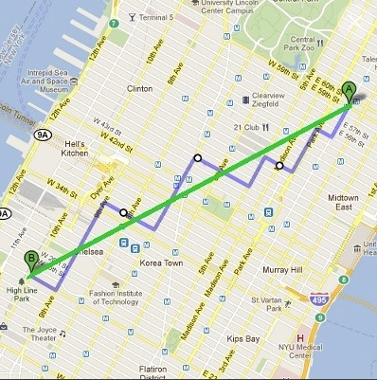
Measure of Dissimilarity
Clustering depends on a measure of dissimilarity.
What are some types of dissimilarity?
Euclidean distance, Manhattan distance, sample correlation, etc.

Slide 11
Summary
Clustering is unsupervised learning.
Our goal: divide the data into groups so the observations in each group are similar.
Types of clustering algorithms: combinatorial, K-means, K-Medoids, NMF, Mixed-Models, Hierarchical.

